Slide 1
WORKING METHODOLOGIES
Scrum, AGILE, Waterfall

Slide 2
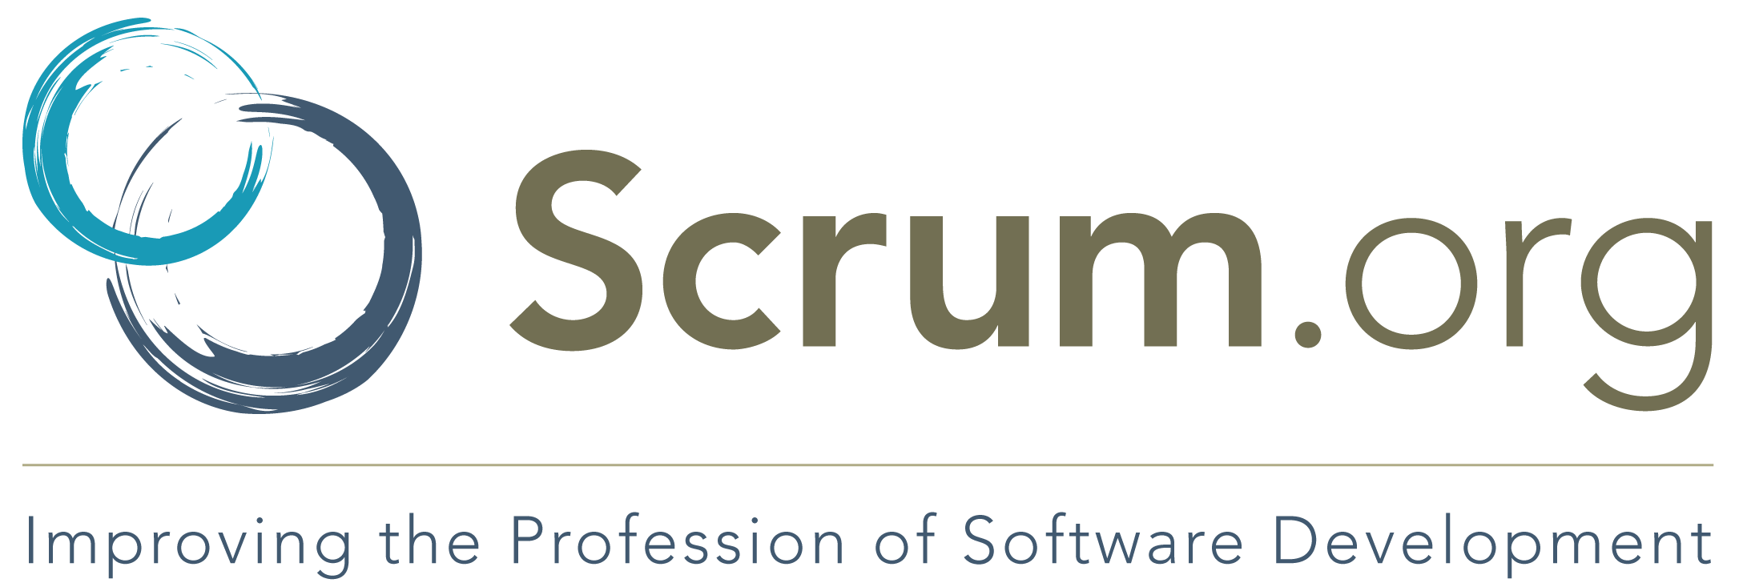
SCRUM
Scrum is simple. It is the opposite of a big collection of interwoven mandatory components. Scrum is not a methodology. Scrum implements the scientific method of empiricism. Scrum replaces a programmed algorithmic approach with a heuristic one,

Slide 3
SCRUM PROCESS IN REAL WORLD
1
2
3
4
Product Backlog
Plan
Sprint Backlog
Duration
Product owner creates a product backlog
Scrum team conducts a sprint planning session
Team creates a sprint backlog and plans its implementation
Team decides a time duration for every sprint
5
6
7
Standup
Guidance
Review
Team gets together every day for a brief Scrum meeting
Certified Scrum master guides the team and keeps them focused and motivated
Stakeholders and the product owner conduct a review at the end of each sprint

Slide 4

PROS AND CONS
PROS
CONS
Scrum can help teams complete project deliverables quickly and efficiently
Large projects are divided into easily manageable sprints
Developments are coded and tested during the sprint review
Works well for fast-moving development projects
Scrum, being agile, adopts feedback from customers and stakeholders
Scrum often leads to scope creep, due to the lack of a definite end-date
The chances of project failure are high if individuals aren't very committed or cooperative
Adopting the Scrum framework in large teams is challenging
Daily meetings sometimes frustrate team members
If any team member leaves in the middle of a project, it can have a huge negative impact on the project

Slide 5
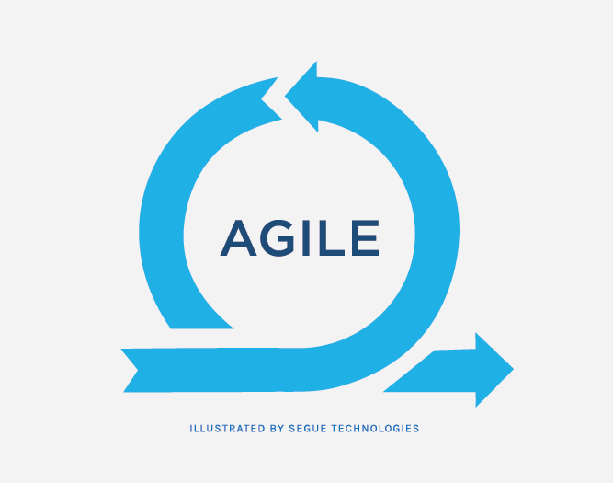
AGILE
Agile is a process by which a team can manage a project by breaking it up into several stages and involving constant collaboration with stakeholders and continuous improvement and iteration at every stage.

Slide 6
AGILE PROCESS IN REAL WORLD
1
2
3
Scope
Requirements
Iteration
Team scopes out and prioritizes projects
Work with stakeholders to determine requirements
Developers begin work on their first iteration of the project, with the goal of having a working product to launch at the end of the sprint
4
5
6
Release
Support
Retirement
Test, address any defects, finalize the system, and release the iteration into production
Your team should keep the system running smoothly and show users how to use it
You remove the system release from production, typically when you want to replace a system with a new release

Slide 7
PROS AND CONS
PROS
CONS
Emphasis on responding to change and focus on working on projects that matter when they matter
Accepts the fact we don’t know everything about a project when we first start
Need for rapid iteration and cyclical, comprehensive reviews as work is completed
Provides the business as a whole more flexibility in when product should be delivered to end users
Less up-front work; focuses us on defining and prioritizing problems to solve
Most people don’t understand what it means to be Agile. As a result, they make unsupported assumptions about what it means.
Flexibility of Agile as a philosophy can lead to teams engaging in bad behaviors, and “blaming” the resulting outcomes on Agile itself
Not every corporate culture is “ready” for the changes Agile requires
Lack of predictability inherent in Agile approaches
Changing to a more Agile approach requires a strong level of discipline in leveraging automated and human testing as part of each work interval

Slide 8

WATERFALL
Waterfall refers to a sequential model for planning, building, and delivering new products and features Each phase has specific activities that must be documented and approved before the next phase can begin.

Slide 9
WATERFALL PROCESS IN REAL WORLD
1
2
3
Req. Analysis
Design
Implementation
Customer requirements are captured in a roadmap and product requirements document
Details any requirements needed to complete the project
Source code is developed based on the requirements. The system is commonly built and tested in small units
4
5
6
Testing
Deployment
Maintenance
The new product or feature is fully tested to make sure it meets the specified requirements
Once the system is fully functional and passes the acceptance criteria, it is deployed into a production environment and made available to customers
Focuses on keeping the system running smoothly

Slide 10
PROS AND CONS
PROS
CONS
Everyone gets up to speed quickly
Since technical documentation is a necessary part of the initial requirements phase, this means that everyone understands the objectives
Timescales are kept
The phased development cycle enforces discipline.
No financial surprises
Costs can be estimated with a fairly high degree of accuracy once the requirements have been defined.
Testing is made easy
Test scenarios are already detailed in the functional specification of the requirements phase, which makes the testing process easier and more transparent
The outcome is crystal clear
Even before the software development starts, the design is hammered out in detail which makes the needs and the outcome clear to everyone.
Needs can be difficult to define
Clients may find it challenging to conceptualise their needs in terms of a functional specification during the requirements phase.
Potential lack of flexibility
Changes due to business plans or market influences may not have been taken into account when planning is all done up front.
Longer delivery time
Projects may take longer to deliver, compared to using an iterative methodology such as Agile.

Slide 11
SOURCES
Scrum Project Management Pros and Cons
The Stages of the Agile Software Development Life Cycle
The Pros and Cons of Agile Product Development
What is waterfall?
Pros and Cons of Waterfall Software Development

